Slide 1
Look through these slides to get an idea of what the various artists on my list are all about or search for your own. Note: There will be no repeat artists – first come first served.
Artist Inspiration
Create a sculpture inspired by, in the eyes of, or in reaction to the artist you choose. Gather information and use the research that you do to help create your piece. At the critique you will be asked to explain what you learned and how you arrived at your final sculpture.

Slide 2
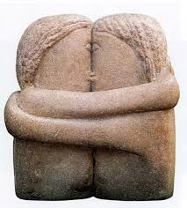
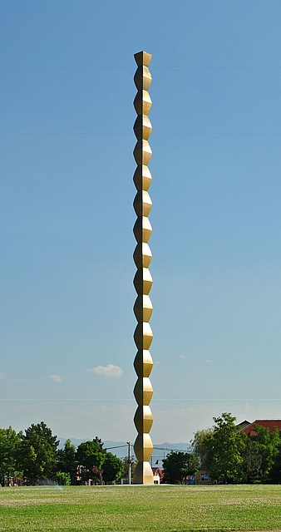
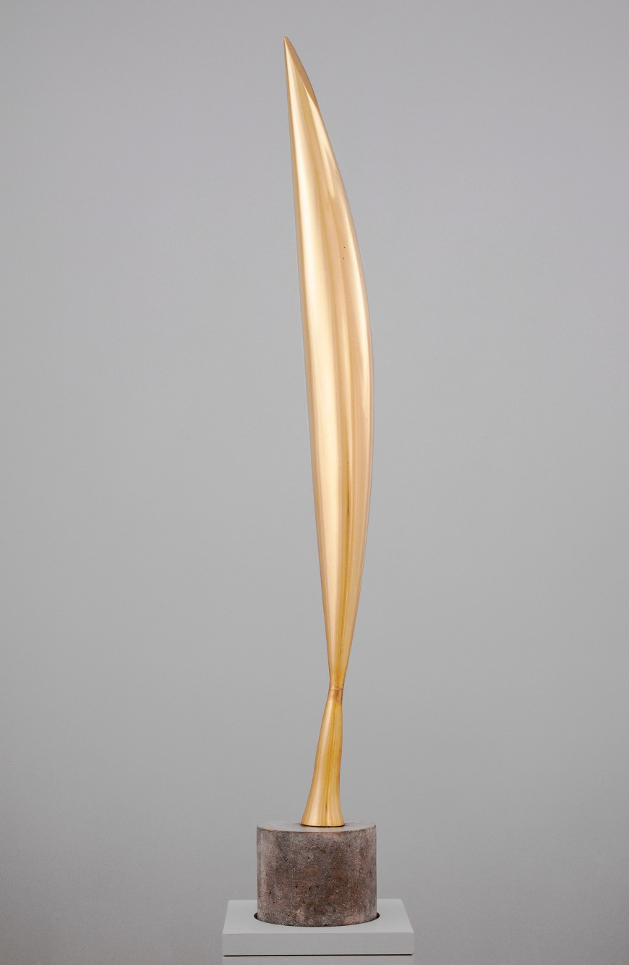
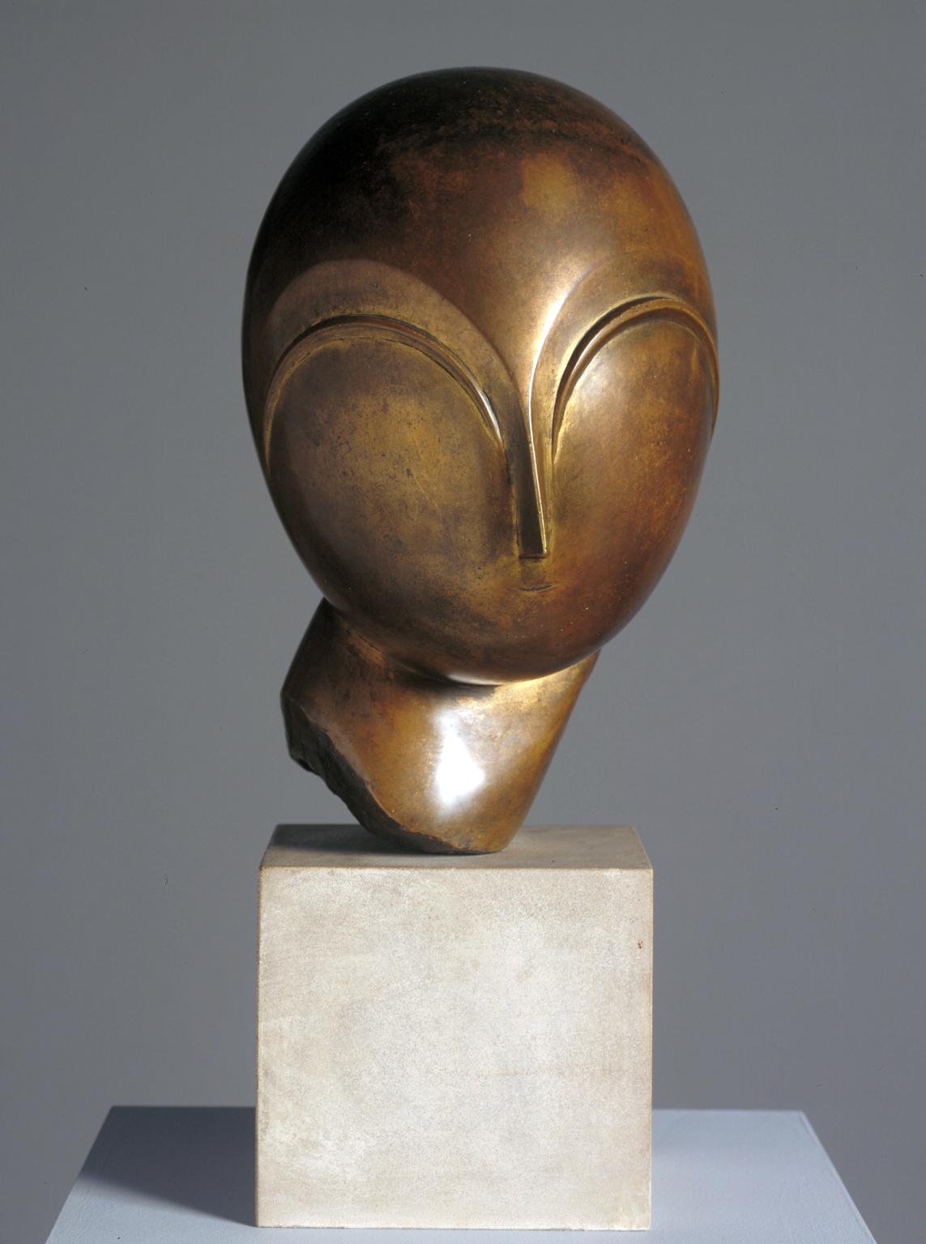
Constantin Brancusi

Slide 3
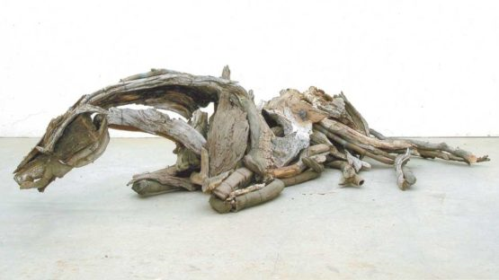
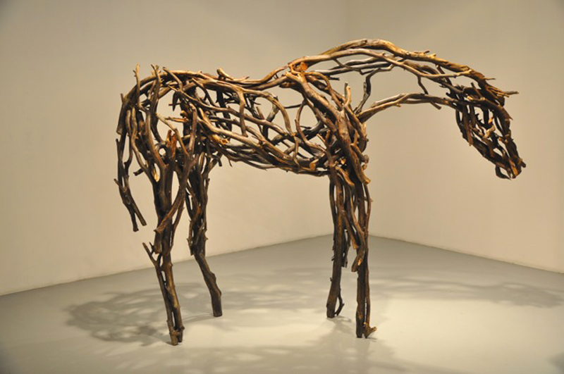
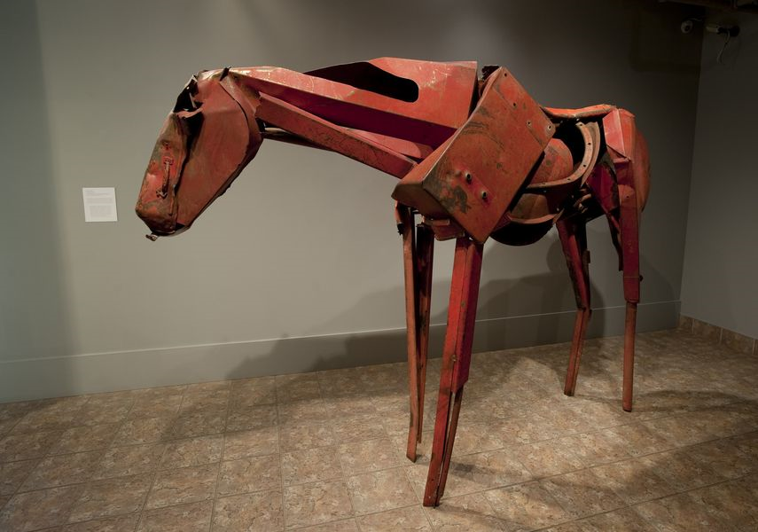
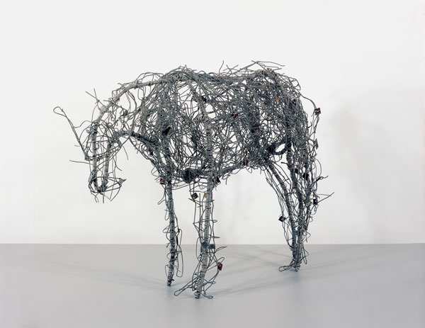
Deborah Butterfield

Slide 4
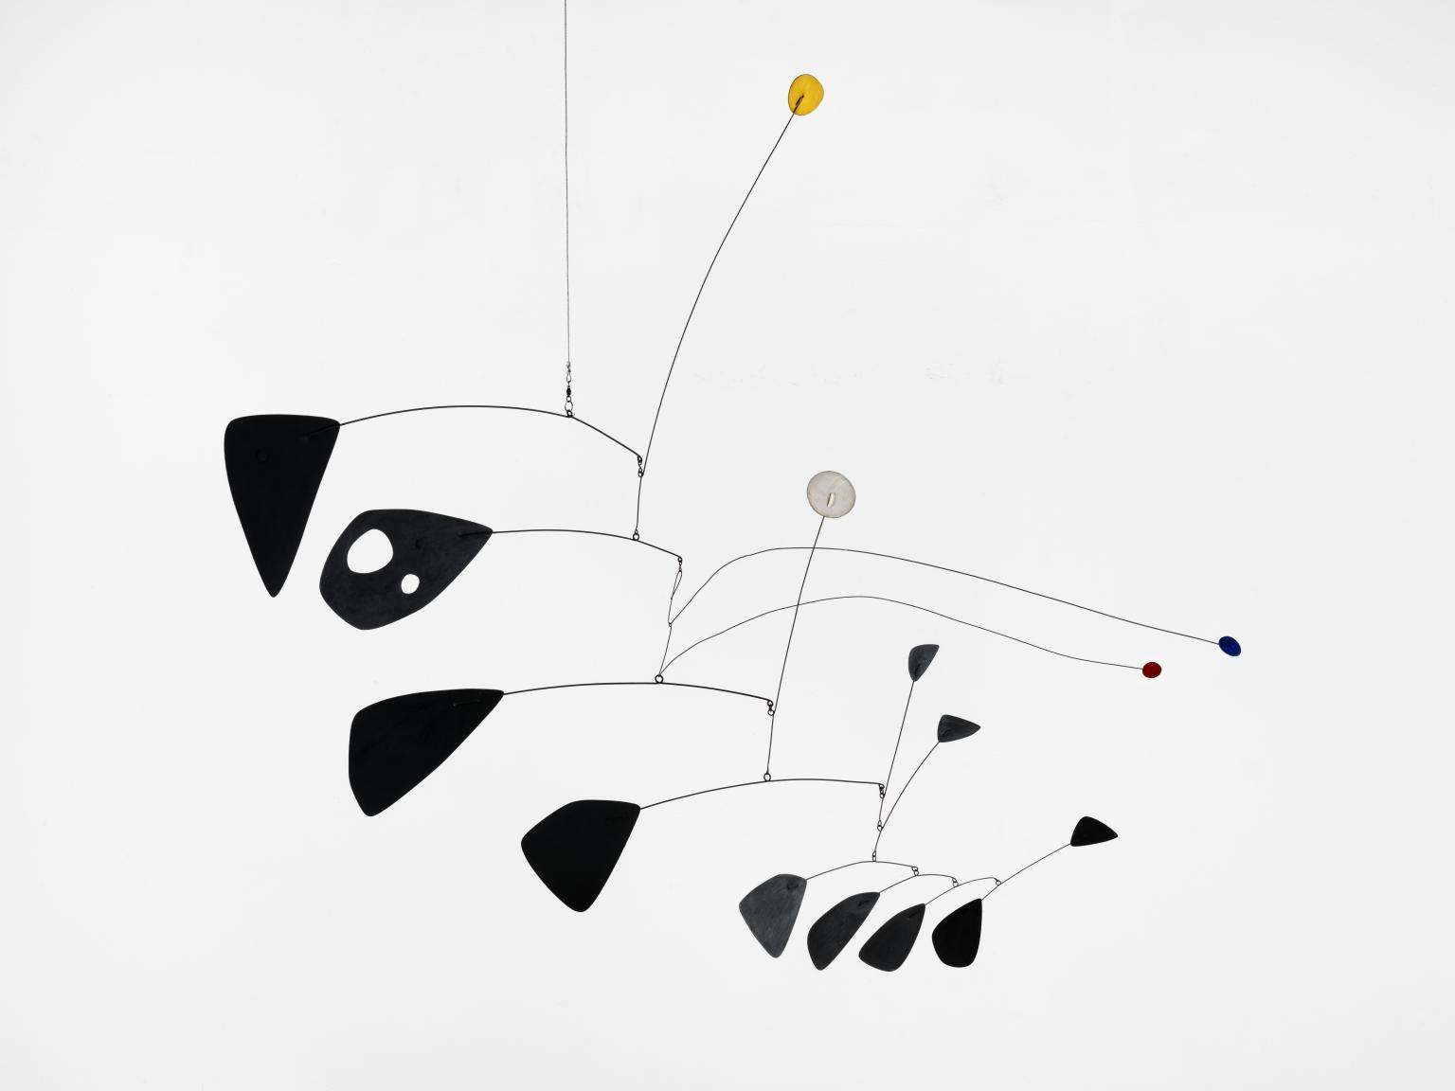
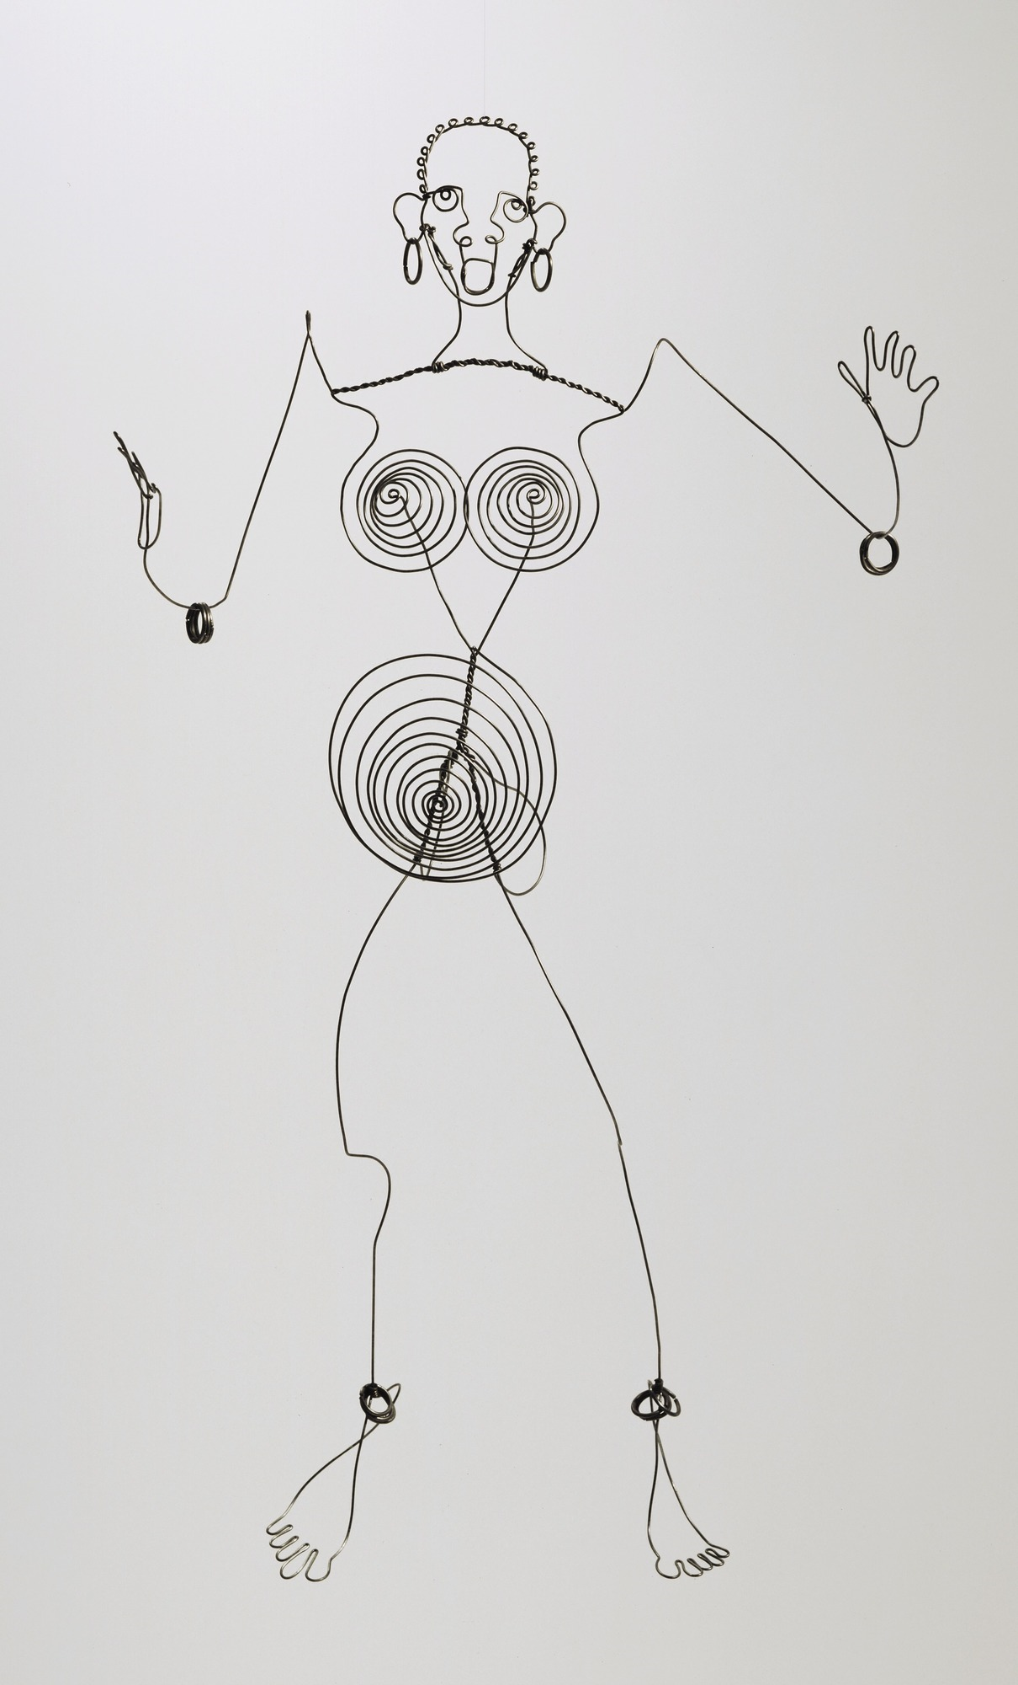
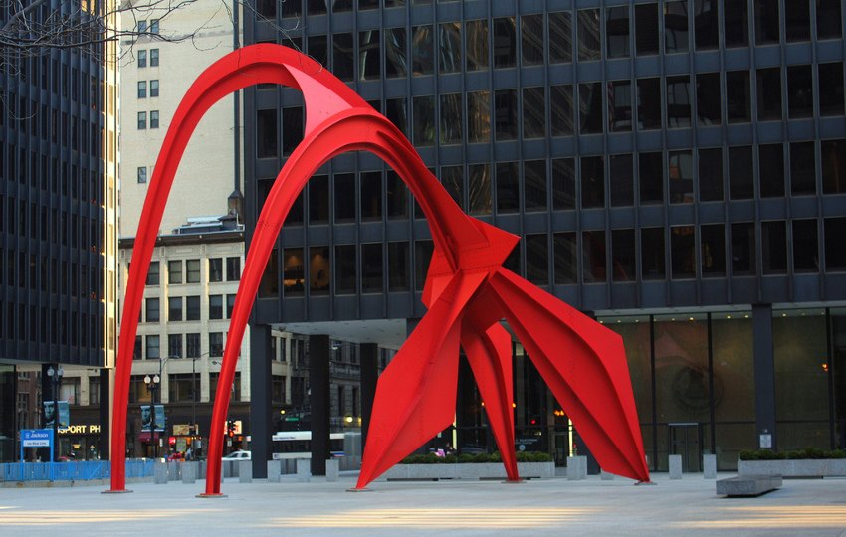
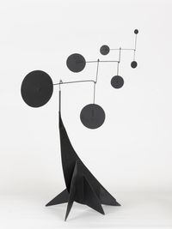
Alexander Calder

Slide 5
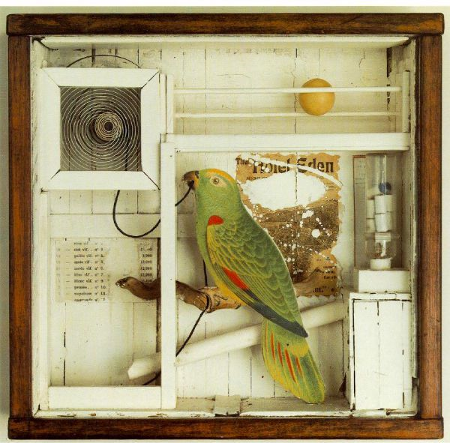
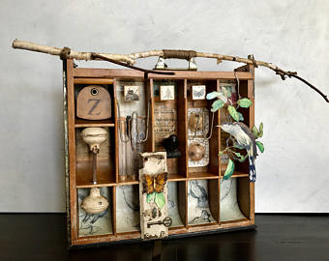
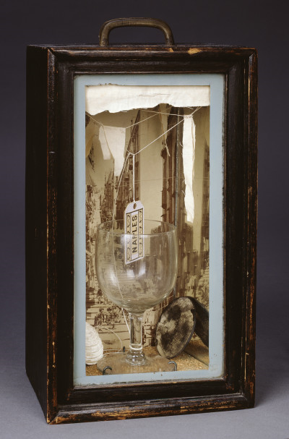
Joseph Cornell

Slide 6
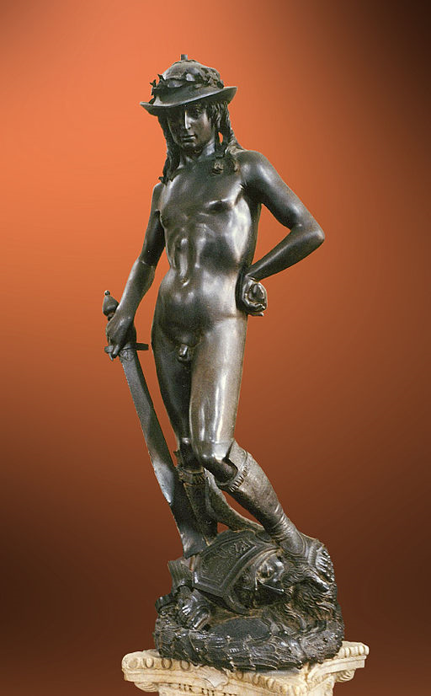
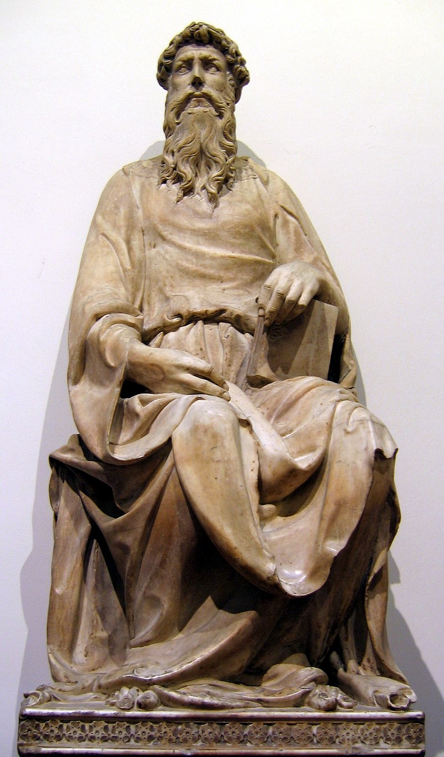
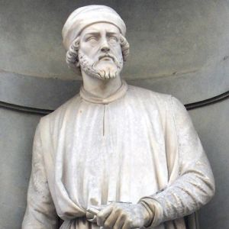
Donatello

Slide 7
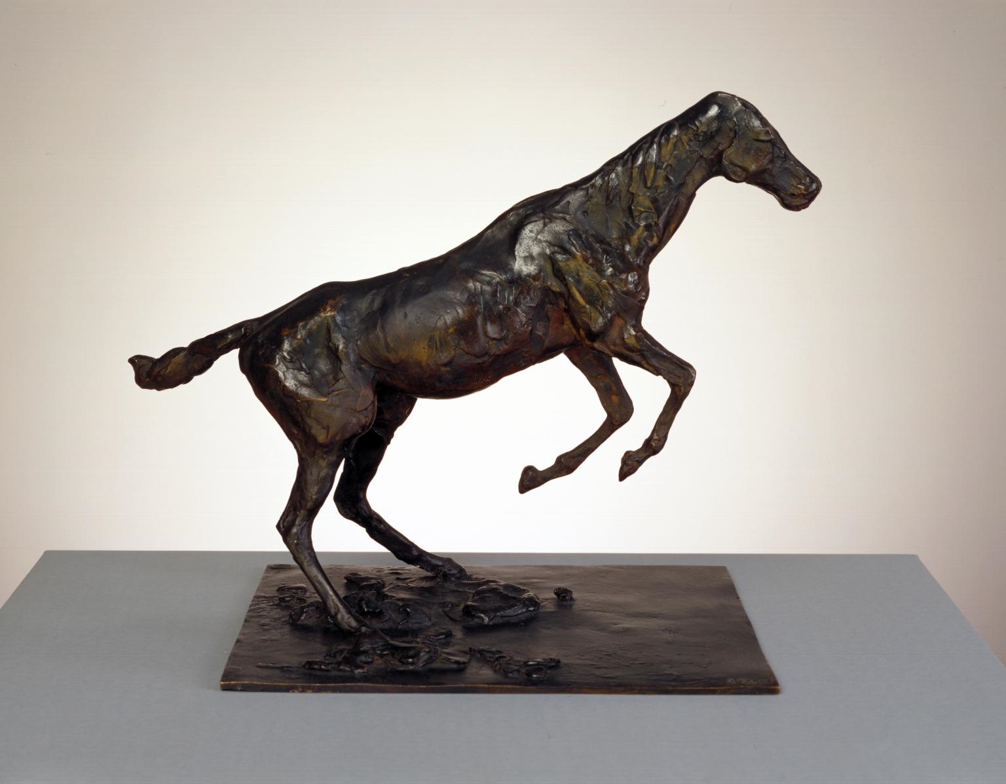
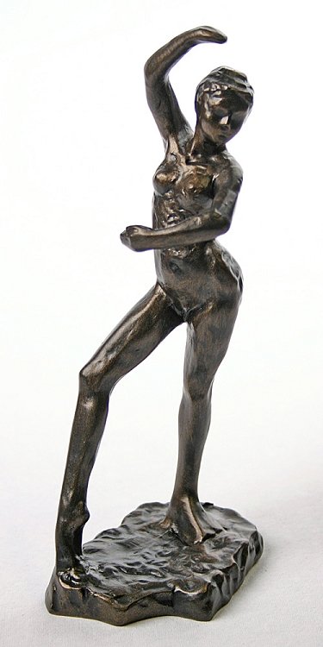
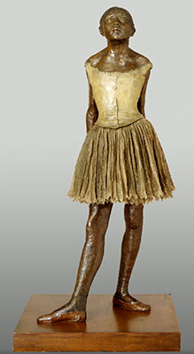
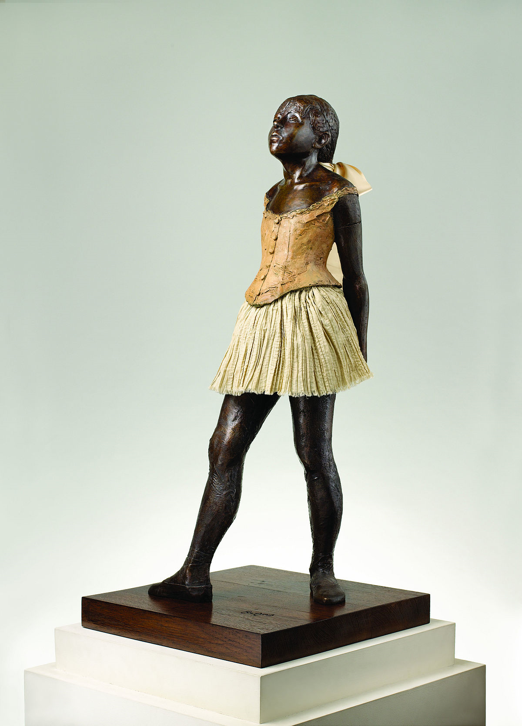
Edgar Degas
(focus on the sculpture not the drawing and painting)

Slide 8
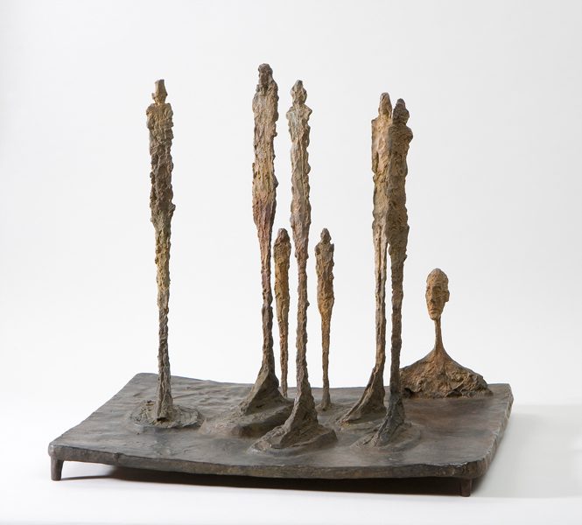
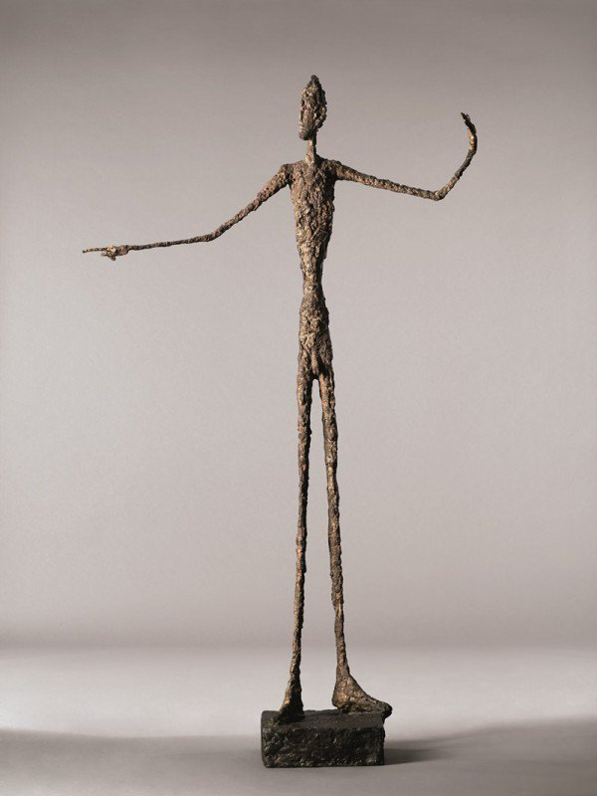
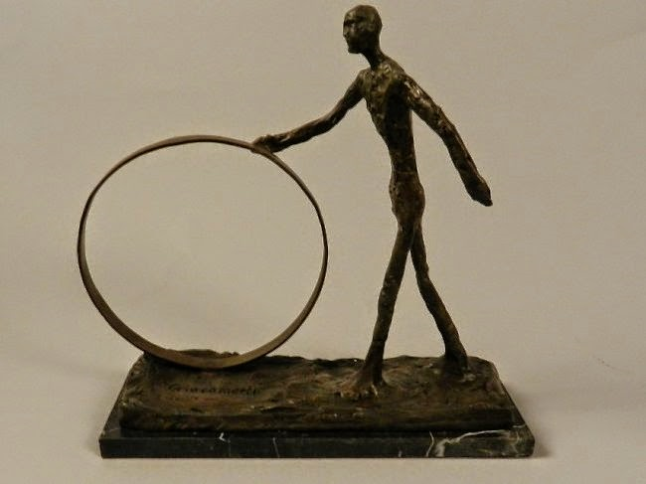
Alberto Giacometti

Slide 9
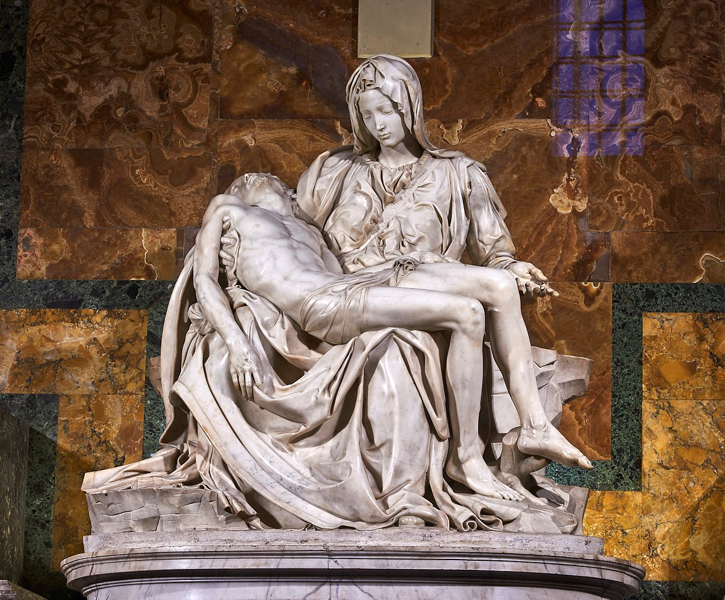
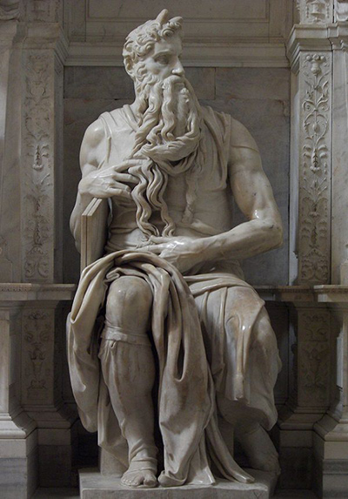
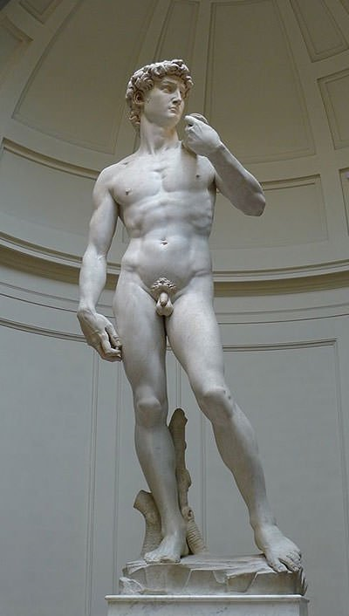
Michelangelo

Slide 10
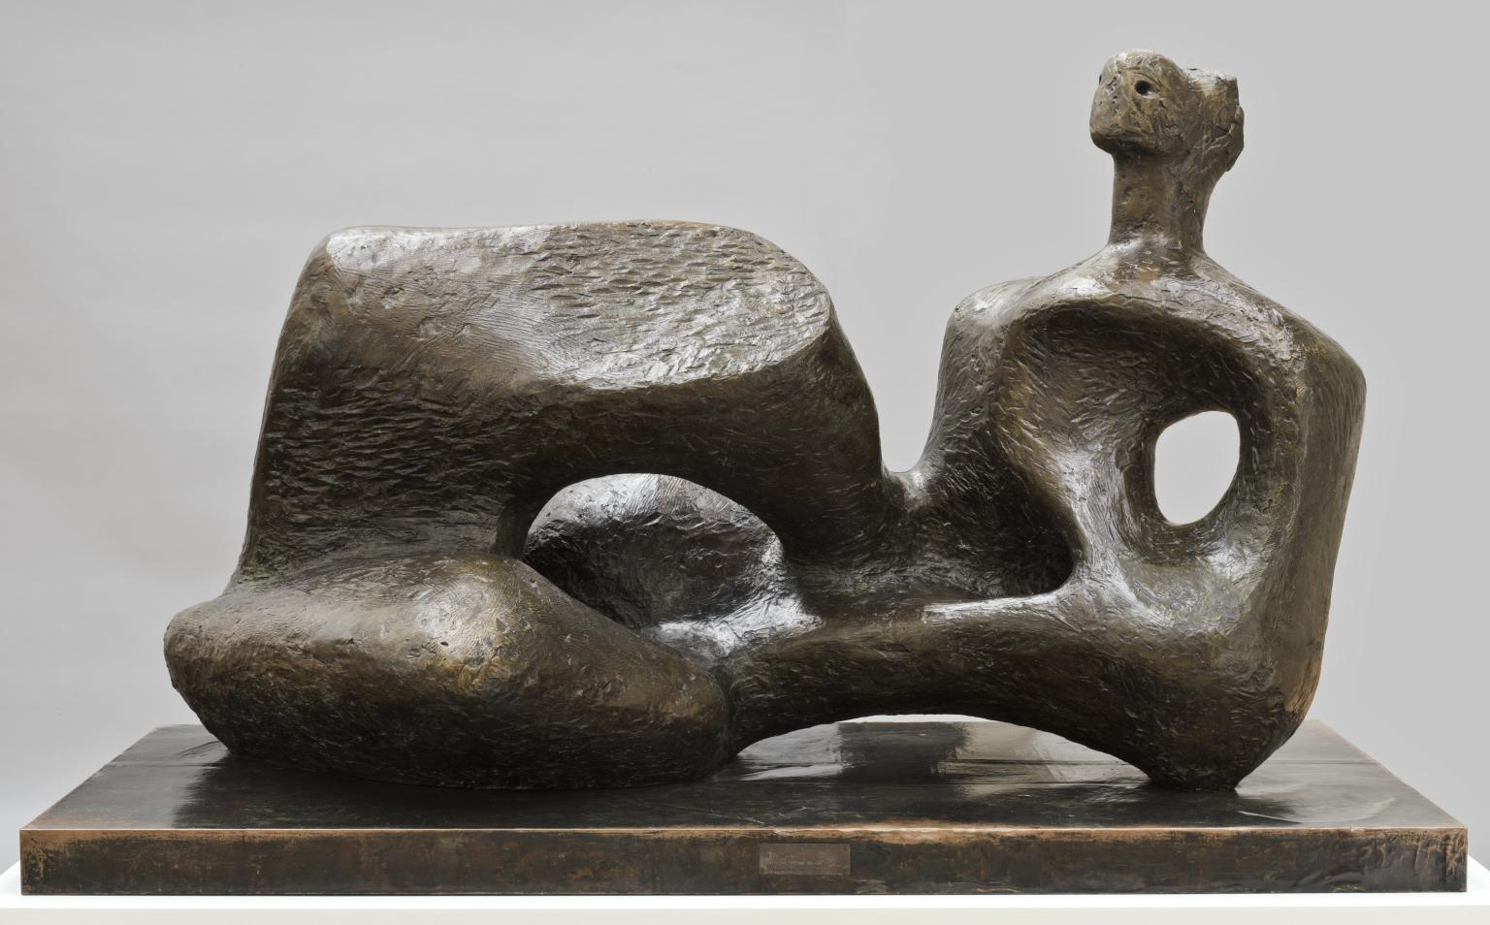
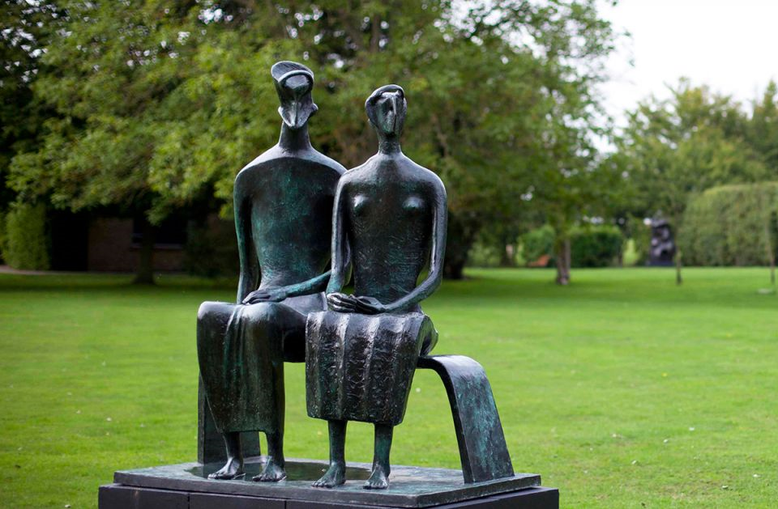
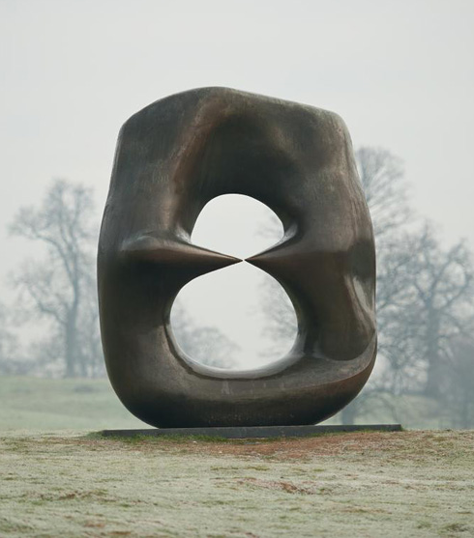
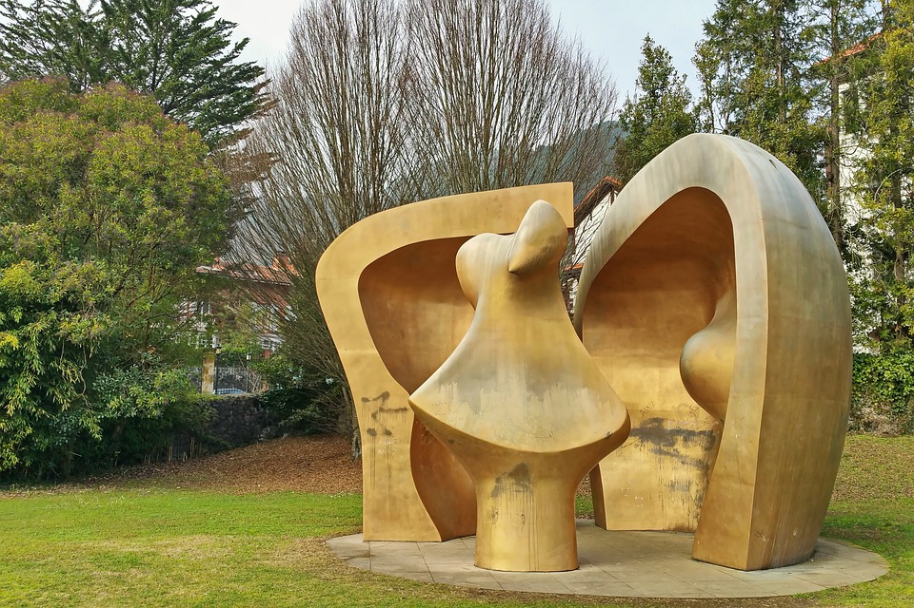
Henry Moore

Slide 11
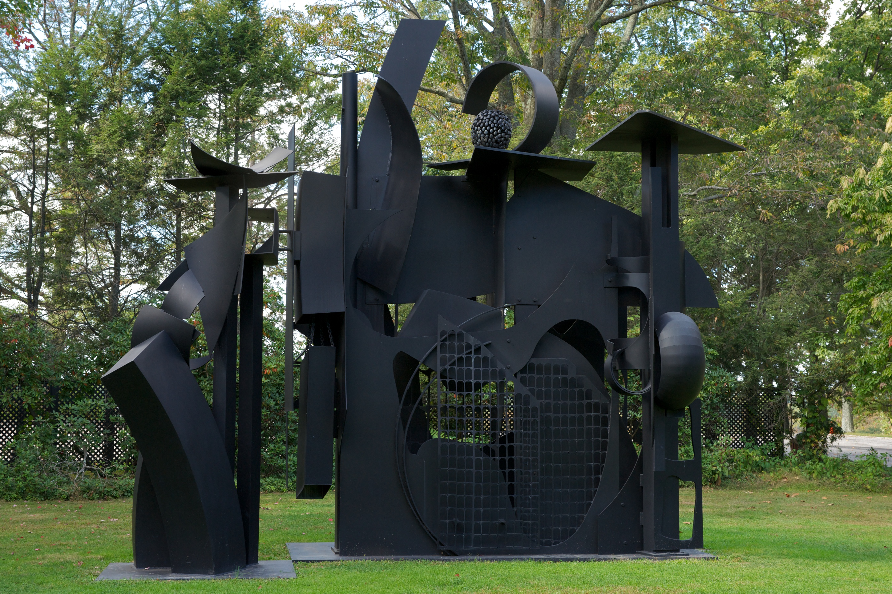
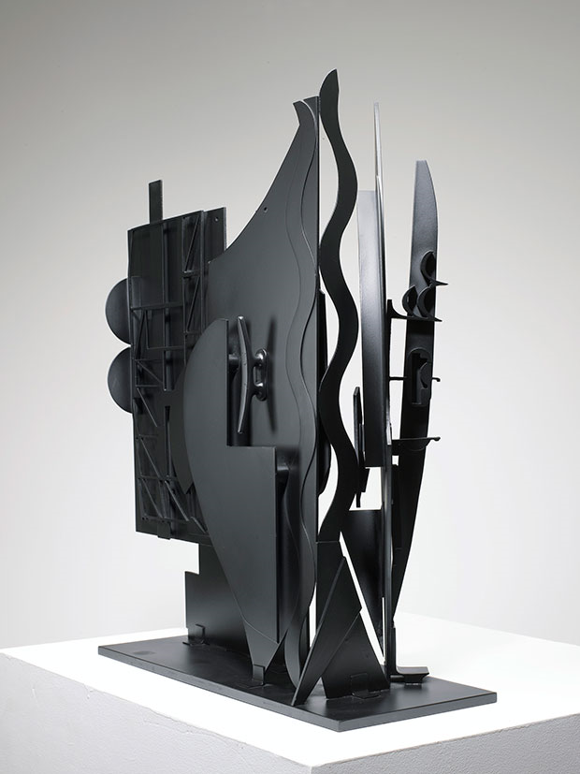
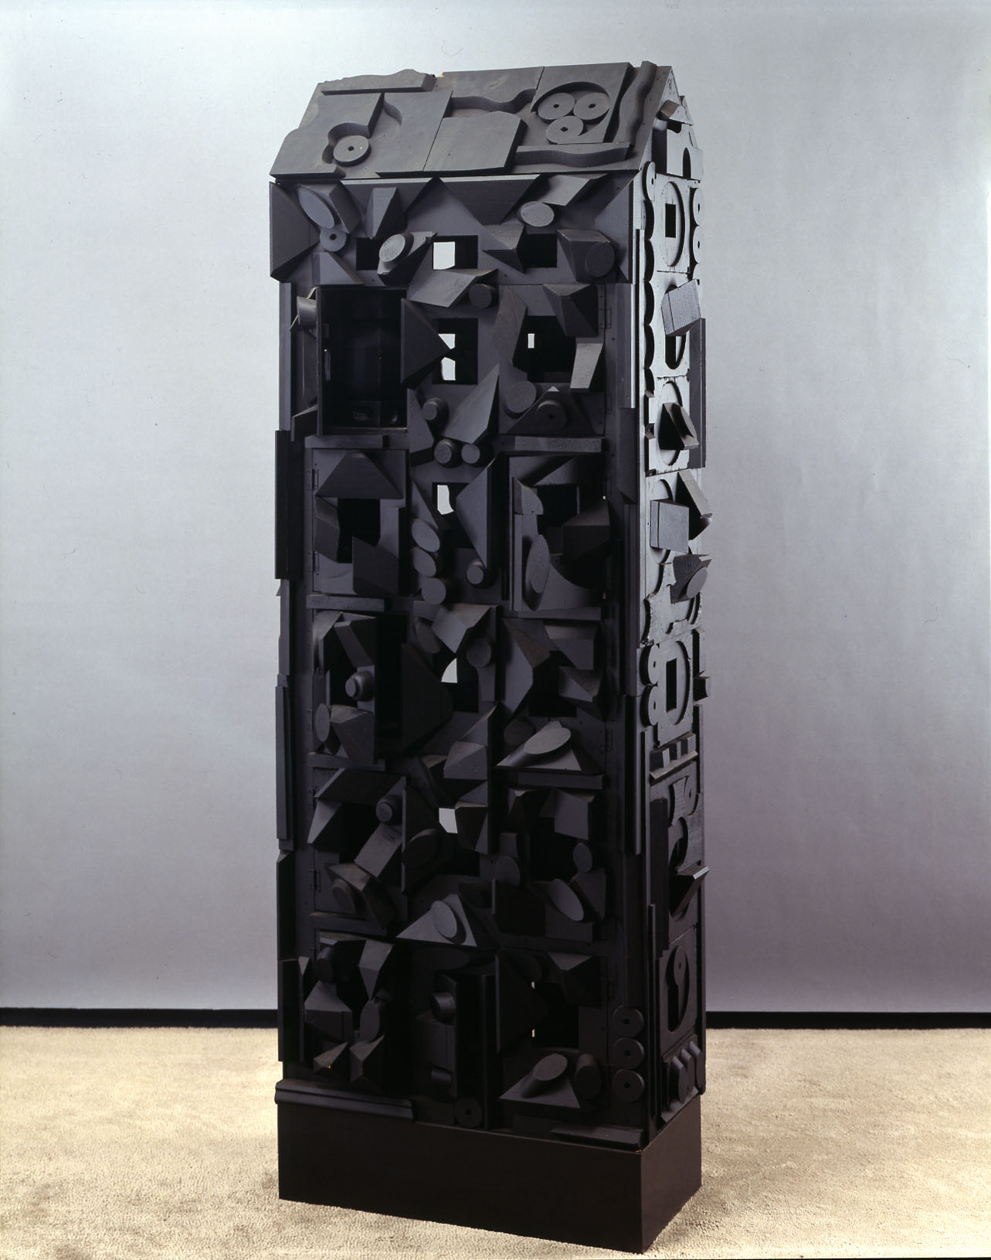
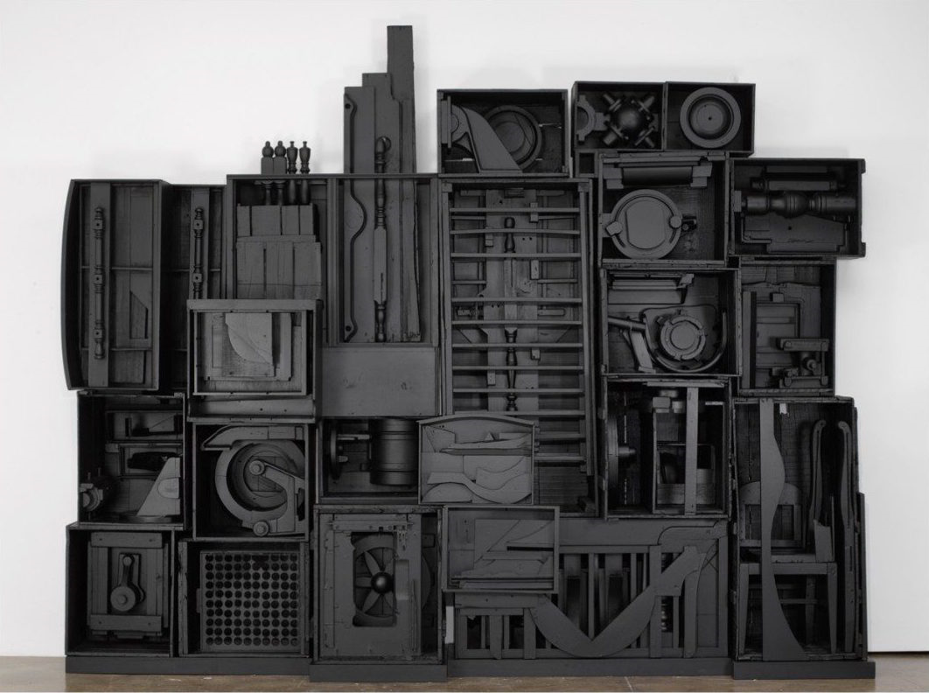
Louise Nevelson

Slide 12
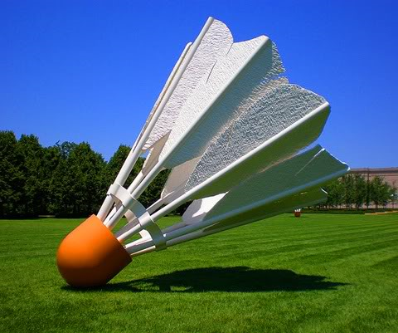
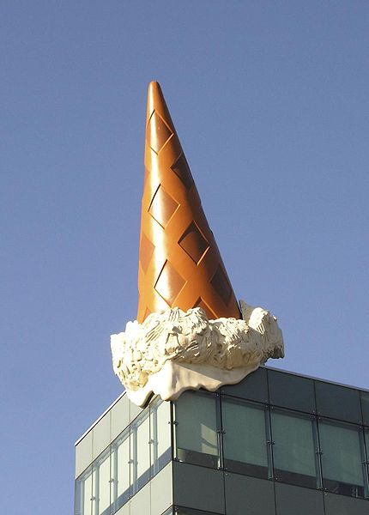
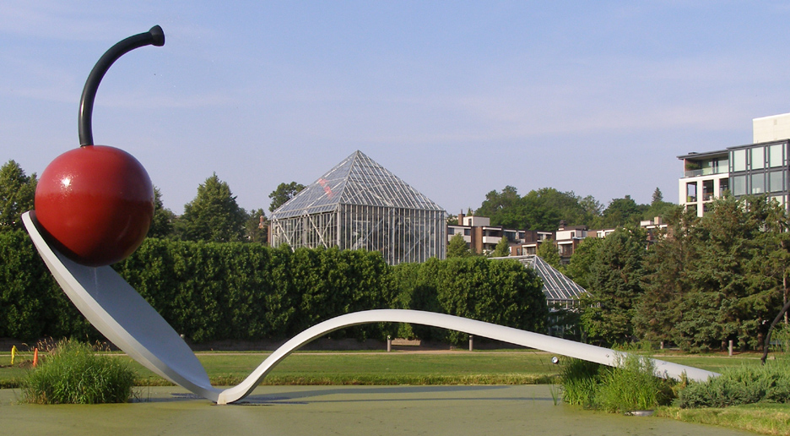
Claes Oldenburg

Slide 13
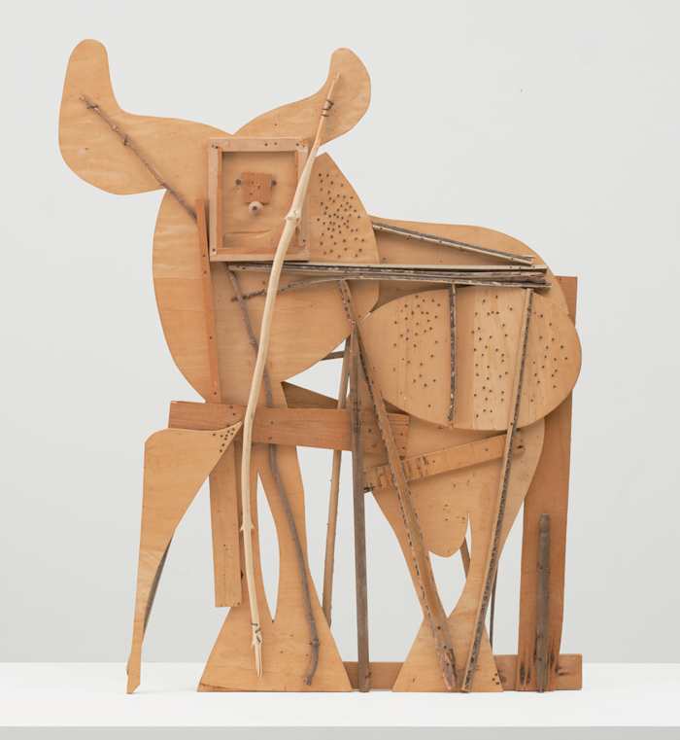
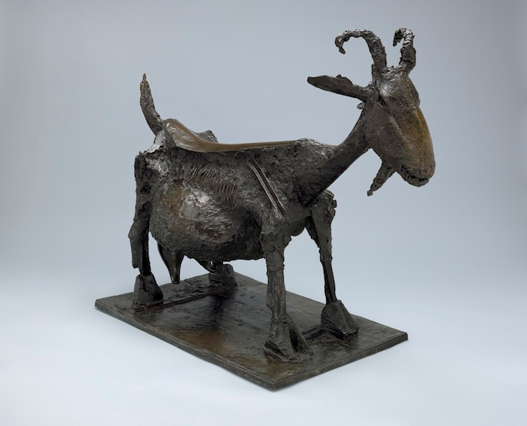
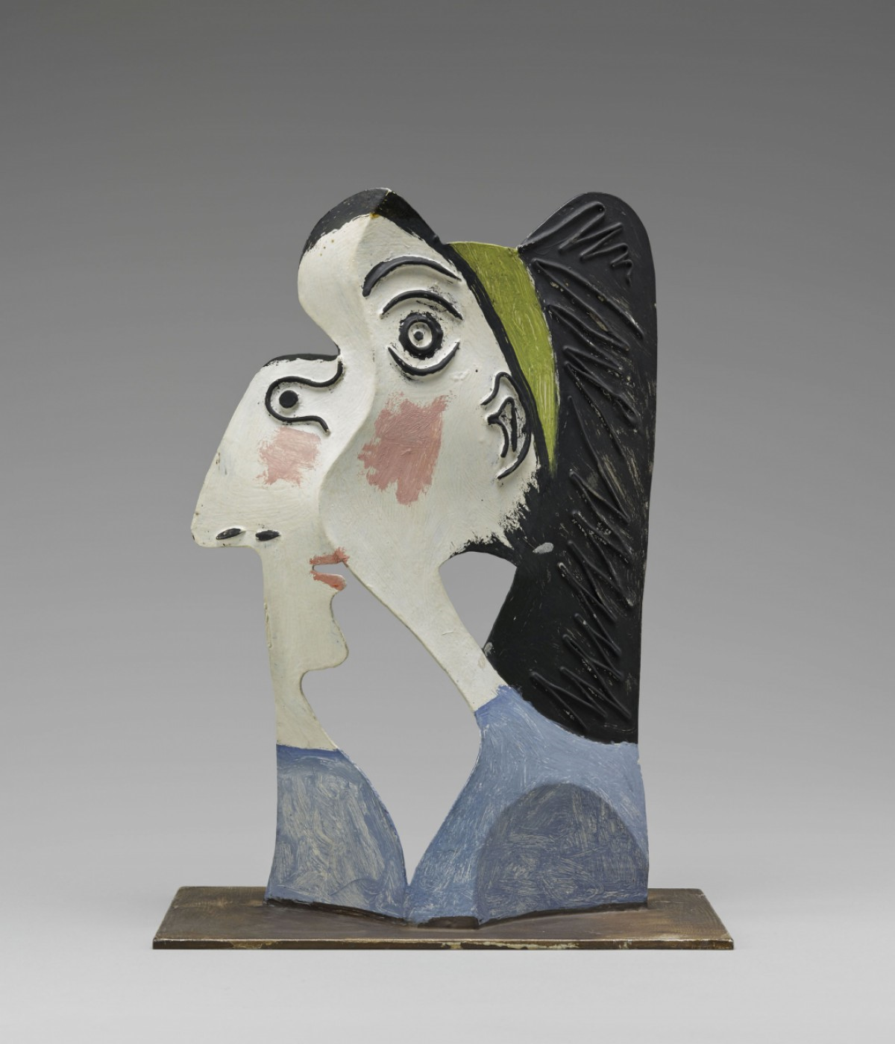
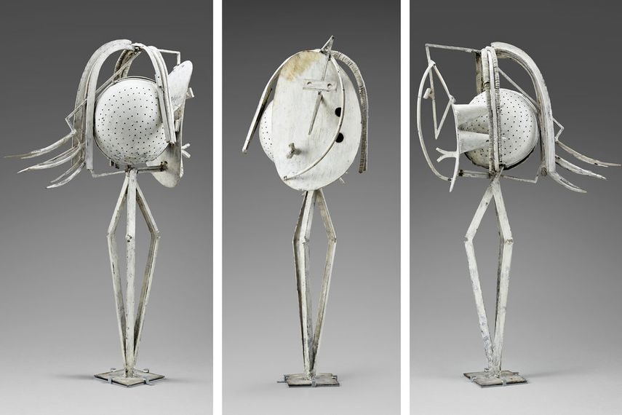
Pablo Picasso
(focus on the sculpture not the drawing and painting)

Slide 14
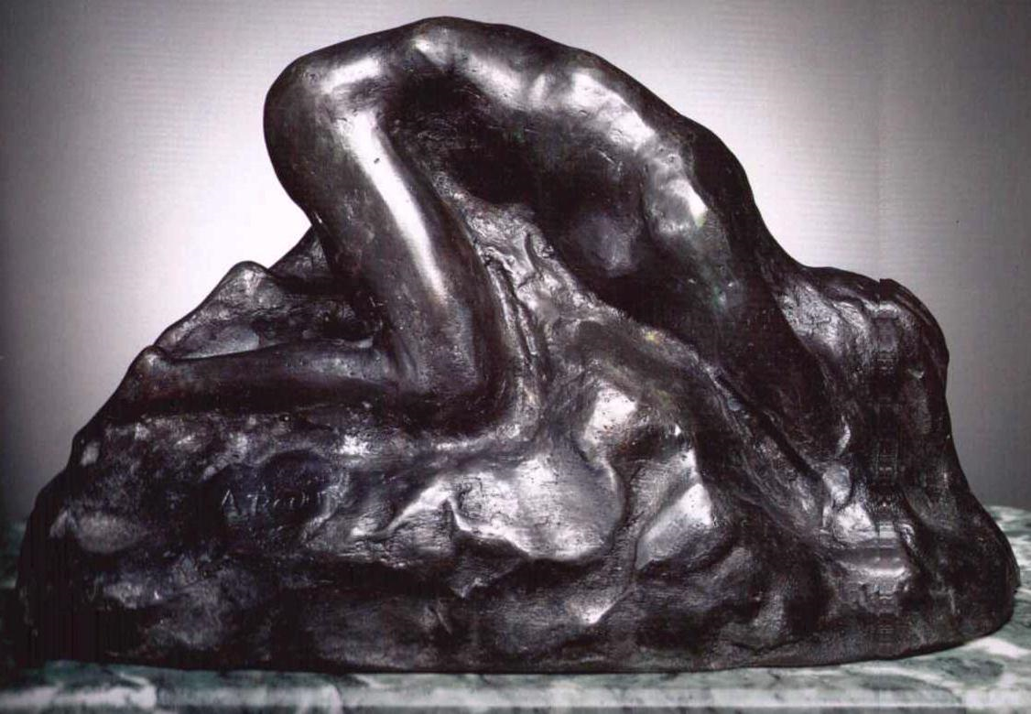
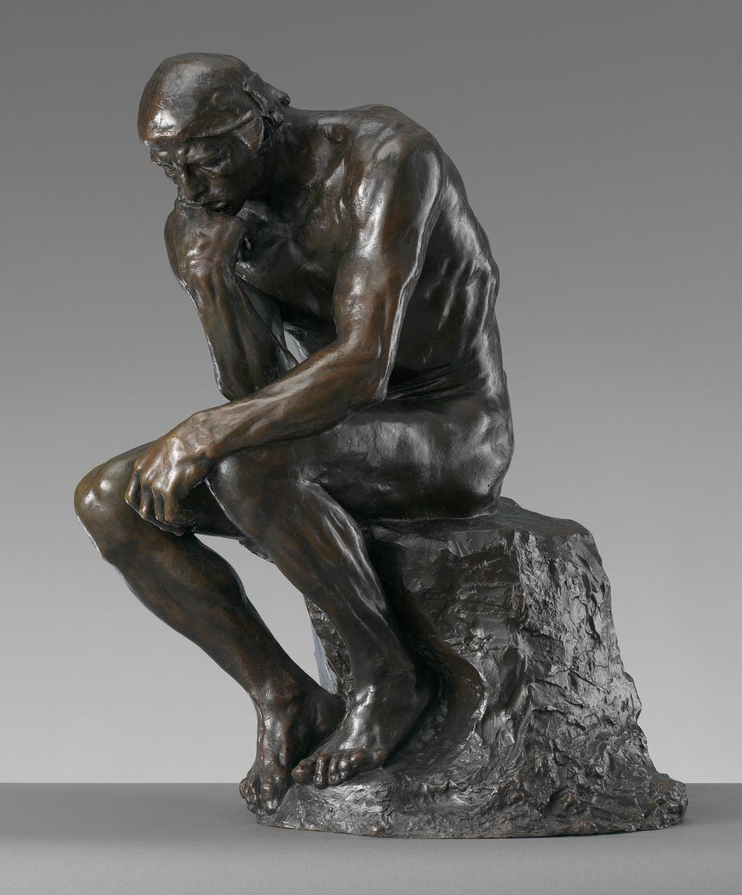
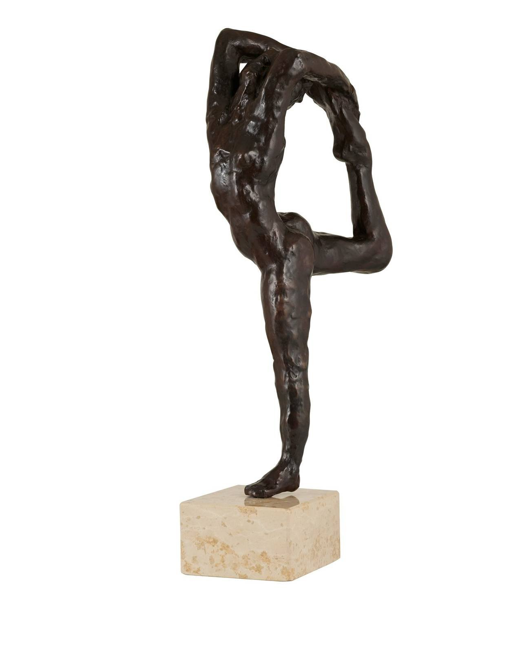
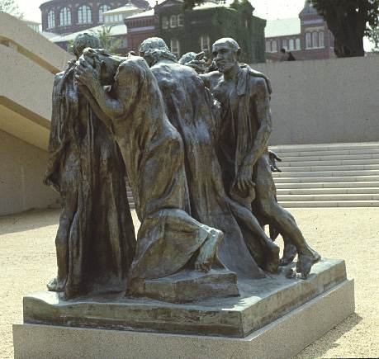
Auguste Rodin

Slide 15
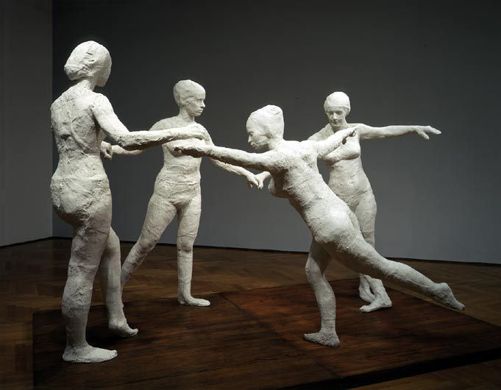
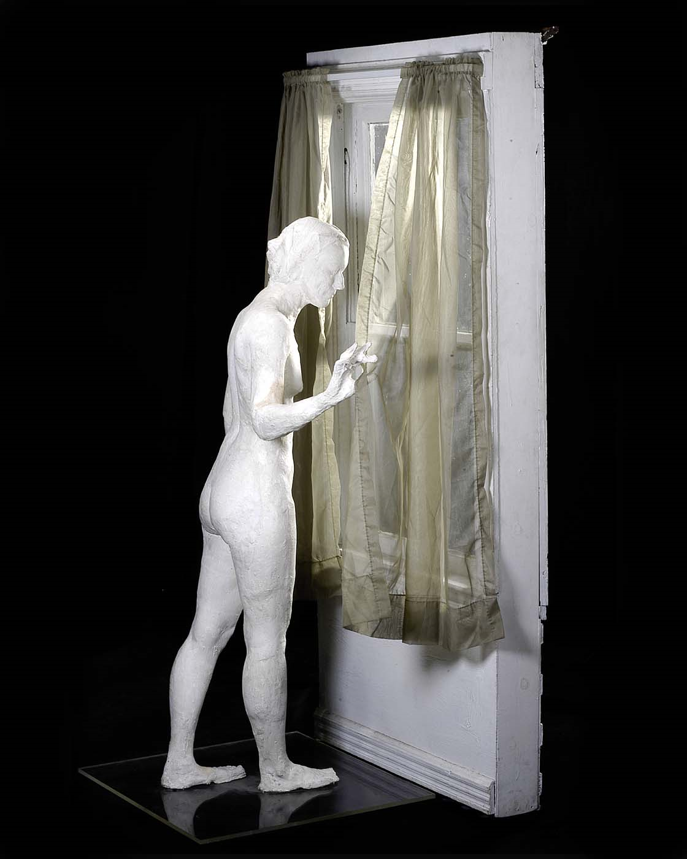
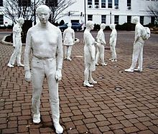

George Segal

Slide 16



David Smith

Slide 17



Eva Hesse

Slide 18



Jasper Johns
(focus on the sculpture not the drawing and painting)

Slide 19



Kenneth Snellson

Slide 20




Ellsworth Kelly

Slide 21



Roy Lichtenstein
(focus on the sculpture not the drawing and painting)

Slide 22



Isamu Noguchi

Slide 23



Beverly Pepper

Slide 24



Robert Rauschenberg

Slide 25



Lucas Sumaras

Slide 26



Frank Stella
(focus on the sculpture)

Slide 27



Rene Magritte
(focus on the sculpture)

Slide 28




Andy Goldsworthy

Slide 29



Jean Arp

Slide 30



Max Ernst
(focus on the sculpture)

Slide 31



Richard Serra

Slide 32
Additional Artists of interest…
Robert Smithson
Christo
Mark di Suvero
Louise Bourgeois
Ai Weiwei
Barbara Hepworth
Umberto Boccioni
Jeff Koons
Maya Lin

